Slide 1
COURSE SUMMARY
Igor Syrytsin
26-04-2024

Slide 2
OVERVIEW
Bits, Data Types, and Operations
Digital Logic Structures
Von Neumann Model and introduction to LC3
Assembly Language
ISA and Pipelining
interrupts, system calls, Exceptions, Scheduling
Storage Technologies and Paging
Concurrency and Multithreaded Programming
IGOR SYRYTSIN, CAOS, SW4 2024

Slide 3
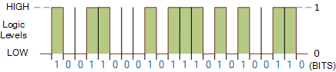
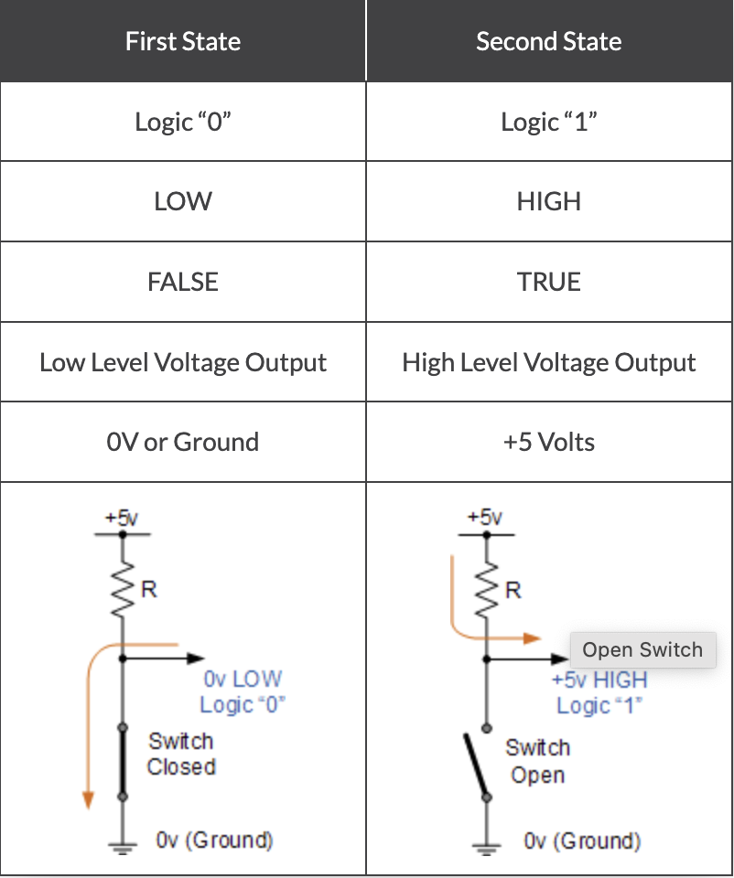
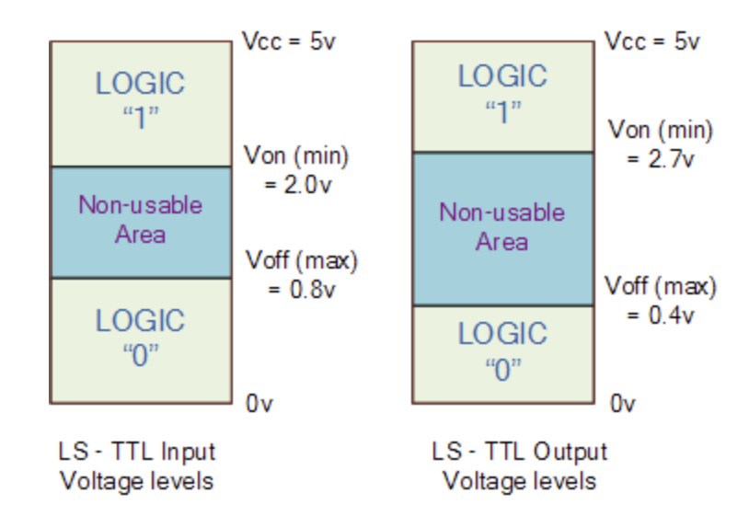
1- The Foundation: Bits

Slide 4
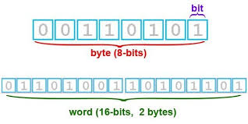
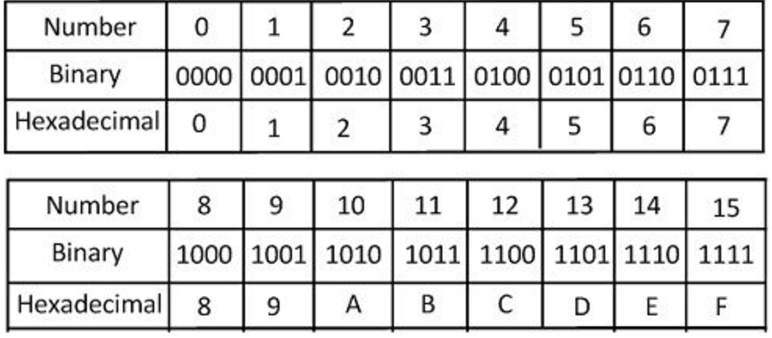
1.1 - Introduction to Bits
A bit is the smallest unit of data in computing, represented as a 0 or 1.
Eight bits form a byte, the fundamental building block of computer data.
A byte can represent values from 0 to 255 in unsigned binary form.
The term "word" often refers to a fixed-sized group of bytes processed together; in many systems, a word is 16-bits or 2 bytes.
Binary numbers are base-2 numerical representations, using only 0 and 1.
Hexadecimal numbers are base-16, extending from 0 to F, where F represents the decimal number 15.
Converting from binary to hexadecimal involves grouping bits in sets of four, with each quartet representing one hexadecimal digit.
The hexadecimal system is often used in computing because it is more compact than binary and aligns well with the byte structure of most computer systems.

Slide 5
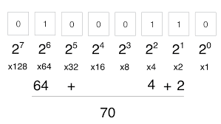
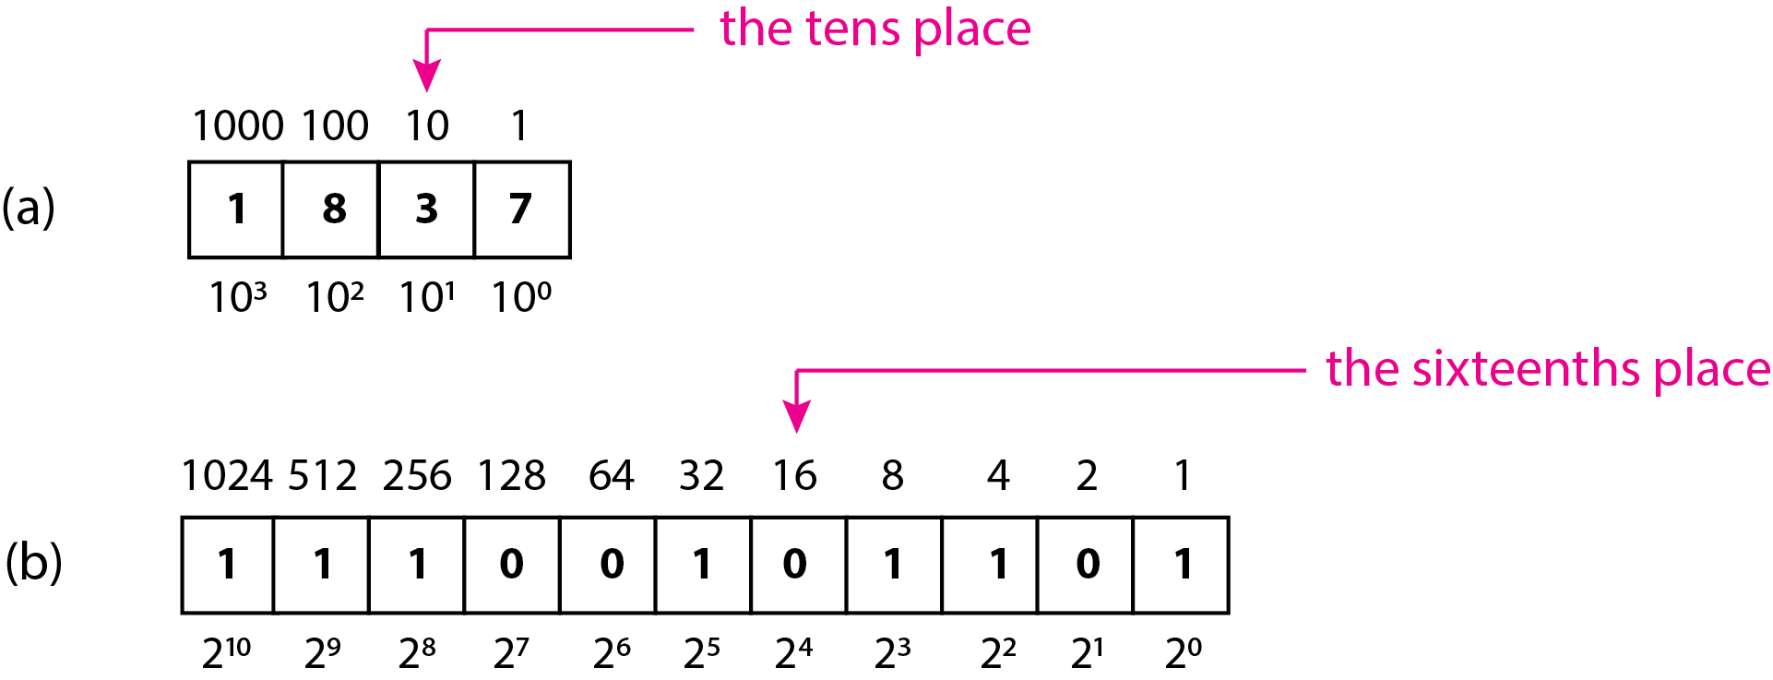
1.2 - Introduction to Bits

Slide 6
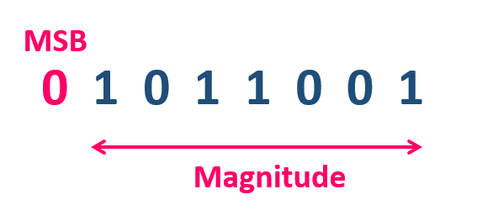
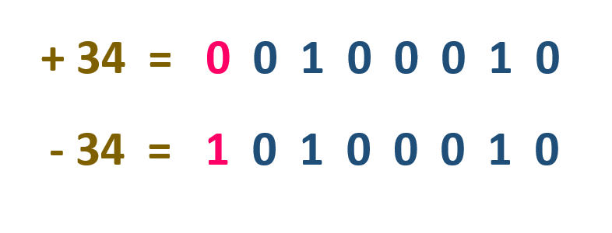
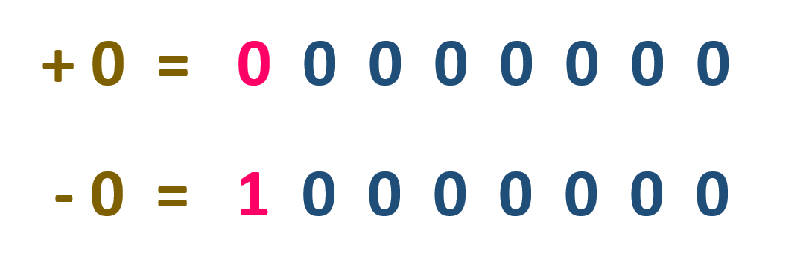
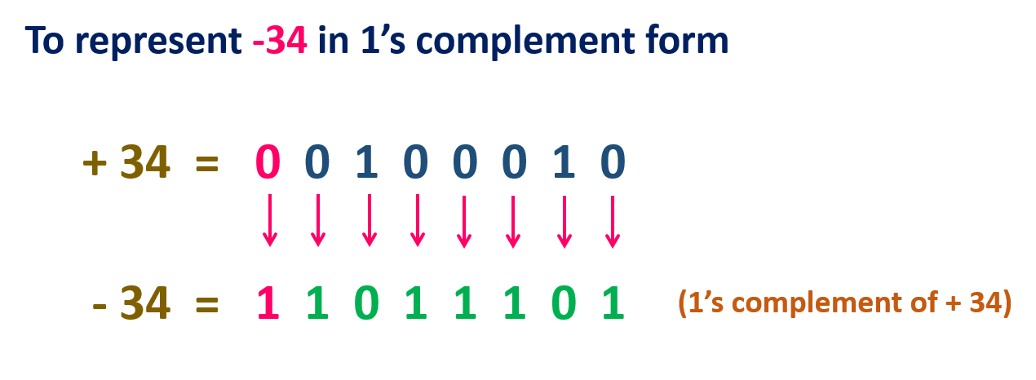
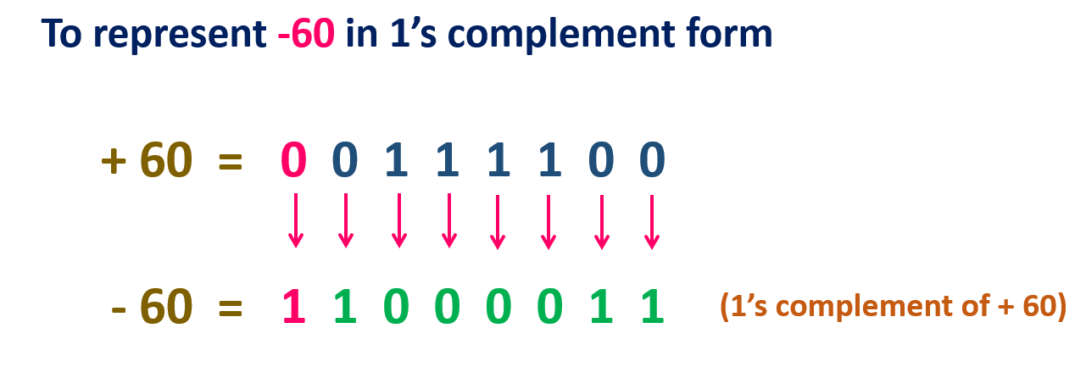
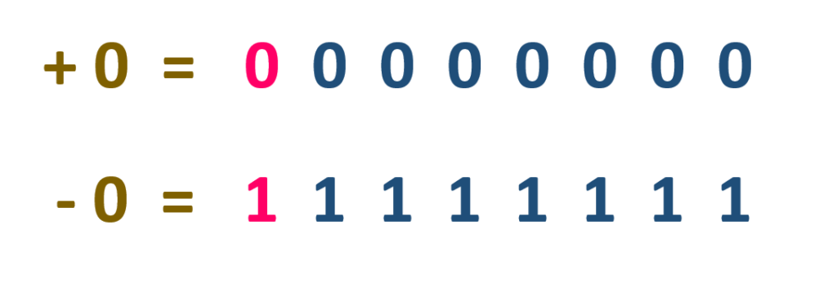
1.3 - Binary numbers representation
Sign Magnitude Representation
1’s Complement Representation

Slide 7
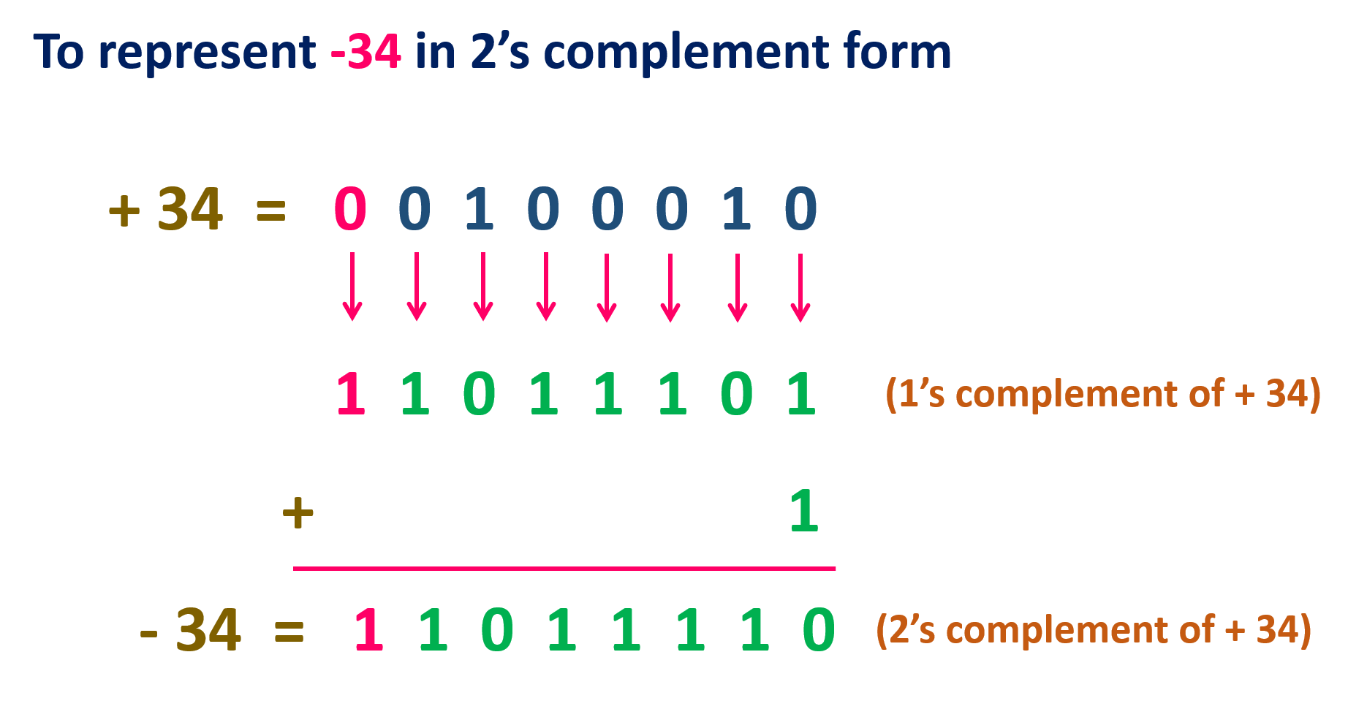
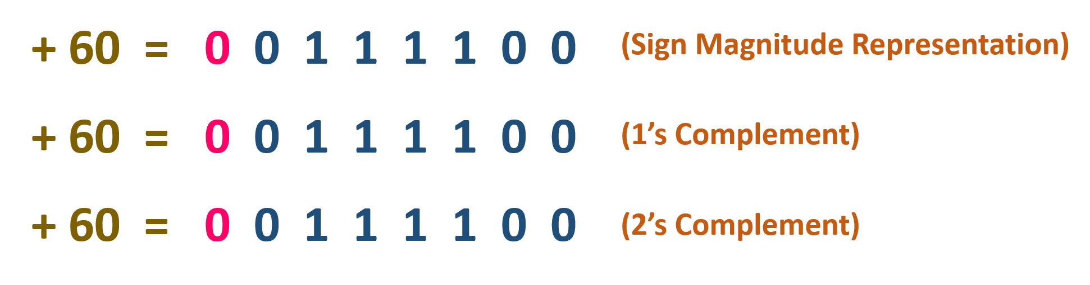
1.4 - Binary numbers representation
2’s Complement Representation
Two's complement is used to perform subtraction in binary and to represent negative numbers.
Subtracting a binary number requires inverting its digits and adding 1, then adding this to the original number.
Overflow in the result indicates a negative number; ignore the overflow bit and consider the sign.
Convert the binary result to decimal by calculating the value of the positive bits and then applying the negative sign.

Slide 8
1.5 – Exercise
Calculate the subtraction of the 5-bit binary numbers 00101 (5 in decimal) and 11010 (-6 in decimal in two's complement) using two's complement, and provide the answer in both binary and decimal.
Solution:
Find the two's complement of the subtrahend 11010 (which is already in two's complement as it's negative):
To confirm, invert all bits of the absolute value 00110 (6 in decimal), which gives 11001.
Add 1 to the least significant bit: 11001 + 1 = 11010. This is indeed the original subtrahend, so it is confirmed as the two's complement of -6.
Perform binary addition with the minuend 00101 (5 in decimal):
00101 (5 in decimal)
+11010 (-6 in two's complement)
-----
11111 (result in binary)
Interpret the result in two's complement. The binary number 11111 in a 5-bit system is -1 in decimal.
So, 00101 (5) - 11010 (-6) in two's complement arithmetic is 11111 (-1) in binary, or -1 in decimal.

Slide 9
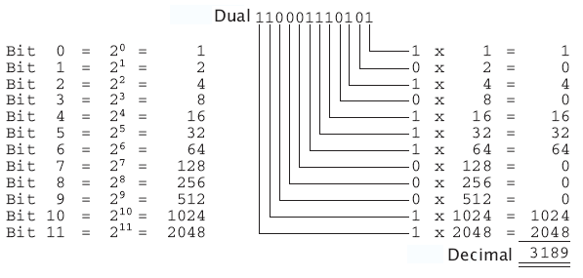
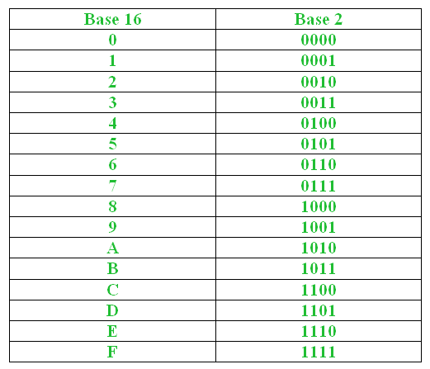
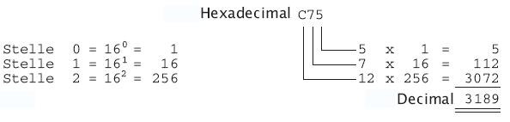
1.6 – HEX – BASE 16

Slide 10
1.7 – Exercise
Consider two hexadecimal numbers: x43 and xA4. What values do they represent for each of the five data types?
 | x43 | xA4
Unsigned Binary | 67 | 164
1’s compliment | 67 | -91
2’s compliment | 67 | -92
Data Type Interpretations:
Unsigned Binary:
The value x43 in hexadecimal converts to 67 in decimal as an unsigned number.
The value xA4 in hexadecimal converts to 164 in decimal as an unsigned number.
1's Complement (Signed):
x43 remains 67 because it's a positive value and within the range of positive numbers for the signed representation.
xA4 is interpreted as -91 in 1's complement because, for negative numbers, 1's complement is calculated by inverting all bits of the positive value of the number and interpreting the result as negative.
2's Complement (Signed):
x43 is still 67 as it is a positive number.
xA4 in 2's complement is interpreted as -92 in decimal. This is derived from 1's complement by adding 1 to the inverted bits of the absolute positive value. It's the standard way of representing negative numbers in binary.

Slide 11
1.8 – Exercise
Consider two hexadecimal numbers: x43 and xA4. What values do they represent for each of the five data types?
 | x43 | xA4
Unsigned Binary | 67 | 164
1’s compliment | 67 | -91
2’s compliment | 67 | -92
x43 in Binary and Hexadecimal:
The hexadecimal number x43 is equivalent to the binary number 01000011.
In an 8-bit system, the MSB here is 0, indicating that it's a positive number.
Thus, x43 is positive and directly translates to the decimal number 67.
xA4 in Binary and Hexadecimal:
The hexadecimal number xA4 translates to the binary number 10100100.
Here, the MSB is 1, which in two's complement representation indicates a negative number.
In two's complement, negative numbers are represented by inverting all bits of their absolute value and adding 1 to the least significant bit (LSB).
The number xA4, when considered as an 8-bit two's complement number, is thus negative.
To find the positive equivalent of xA4, you would invert all bits (01011011), and then add 1, giving 01011100 in binary, which is 92 in decimal. Hence, xA4 represents -92.

Slide 12
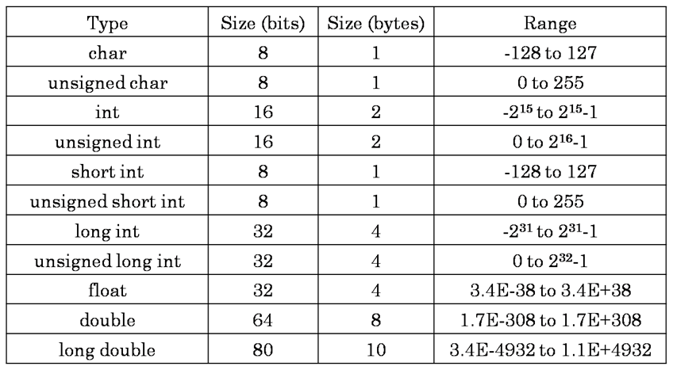
1.9 - Data Types Overview

Slide 13
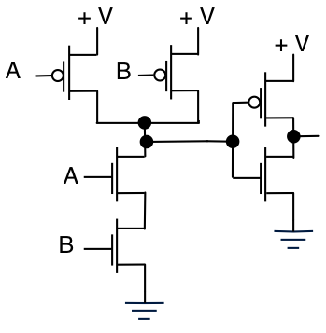
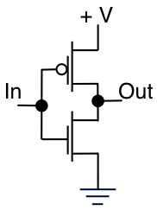
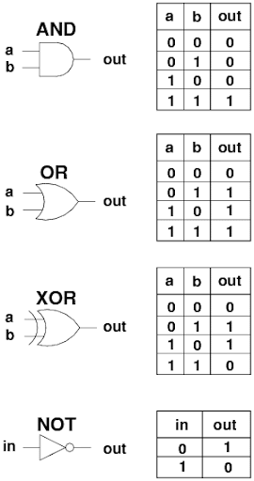
2- Basic Bitwise Operations

Slide 14
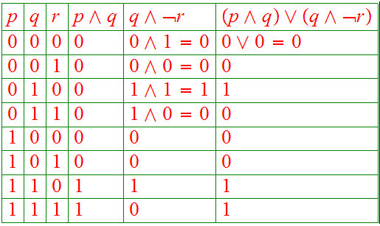
2.1 – exersice
Fill in the truth table for the following logical expression.
F = ((p AND q) OR (q AND (NOT(r)))

Slide 15
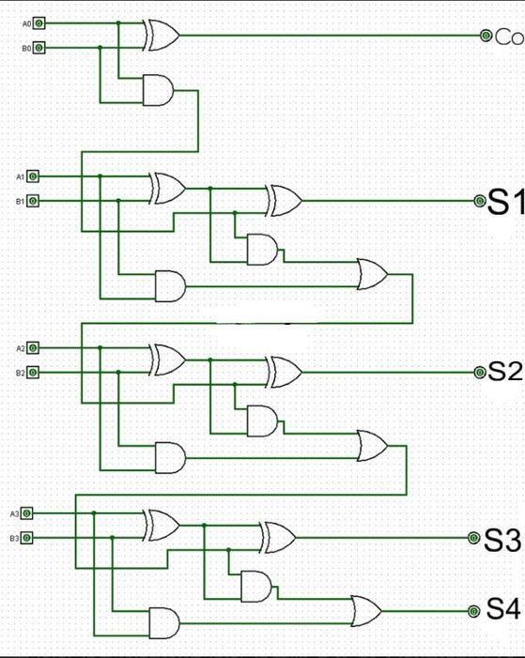
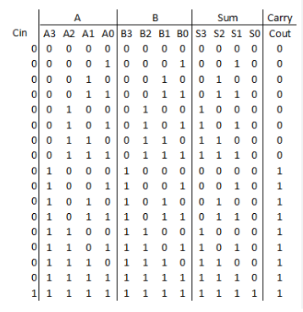
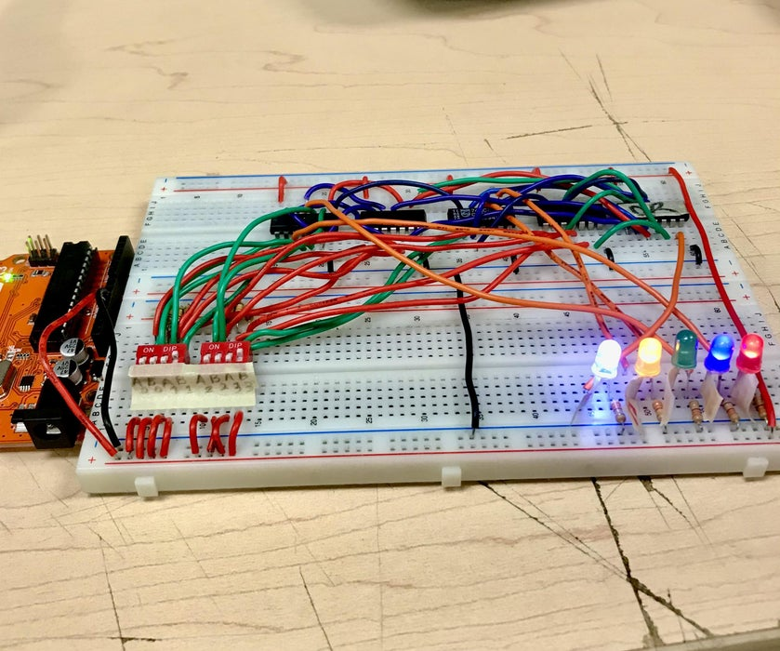
2.2 - 4 bit adder

Slide 16
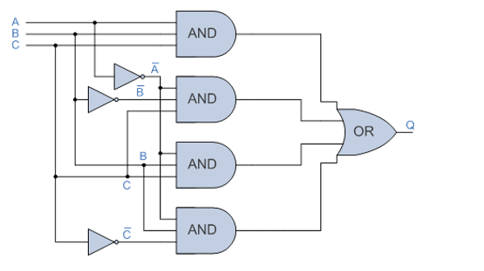
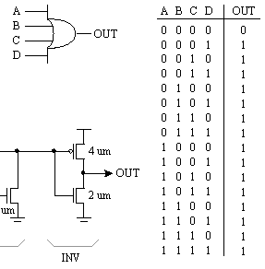
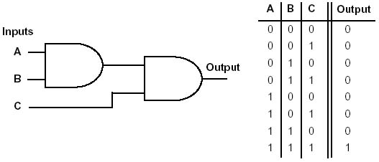
2.3 – Exercise
Construct the output truth table for the following logic circuits

Slide 17
2.4 – Exercise
Construct the output truth table for the following logic circuits
Inverters: IdentifInputs: The truth table needs to list all possible combinations of inputs for A, B, and C, which means you will have 2^3 = 8 different rows for all the possible states (000, 001, 010, 011, 100, 101, 110, 111).
The inputs that go through an inverter (NOT gate) before reaching an AND gate. In this circuit, both A and C are inverted. So, wherever A is 1, ‾A will be 0, and vice versa. The same applies to B and C.
AND Gates: There are four AND gates, each taking different inputs:
The first AND gate takes A, B and C.
The second AND gate takes ‾A, ‾B and C
The third AND gate takes ‾A, B and C
The Fourth AND gate takes ‾A, B and ‾C
OR Gate: The OR gate takes inputs from all four AND gates and outputs 1 if at least one AND gate inputs a 1.
Output (Q)

Slide 18
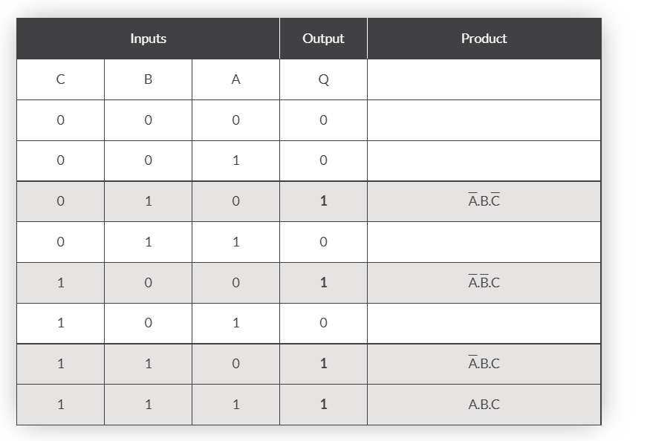
2.5 – Exercise
Construct the output truth table for the following logic circuits

Slide 19
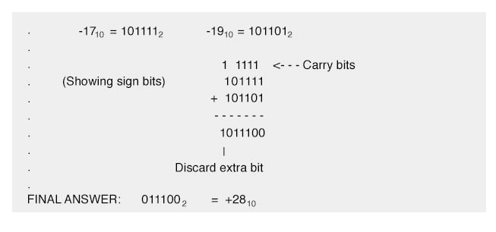
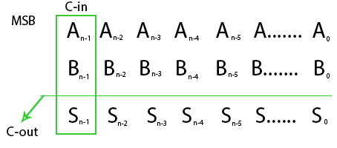
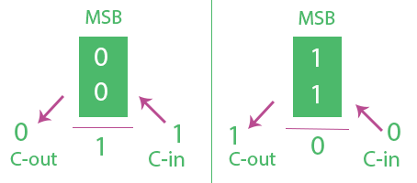
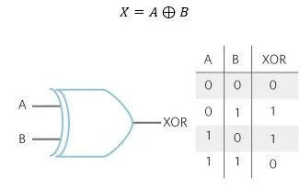
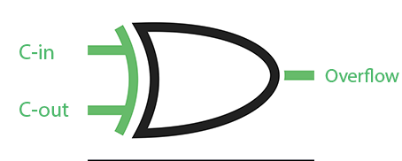
2.6 - Advanced Operations and Data Types

Slide 20
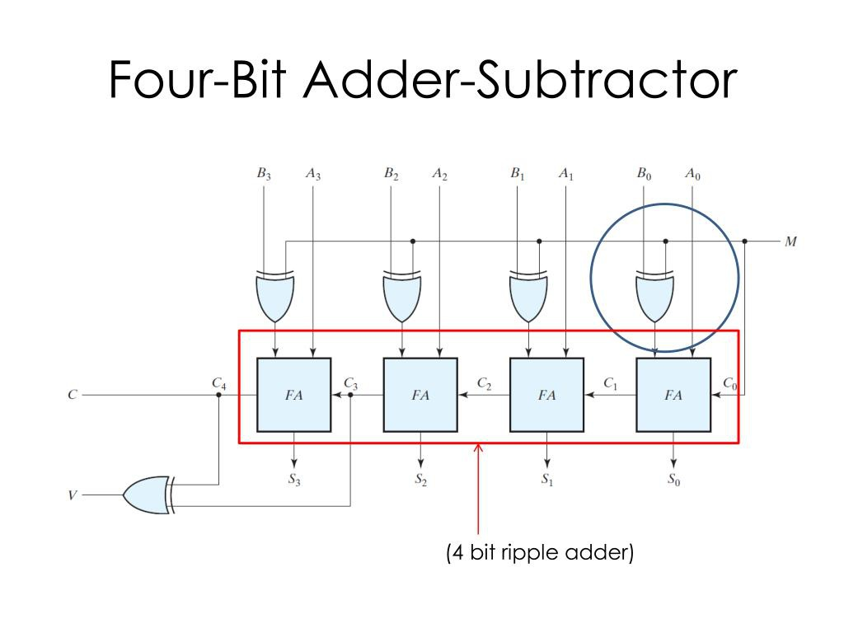
2.7 - Advanced Operations and Data Types

Slide 21
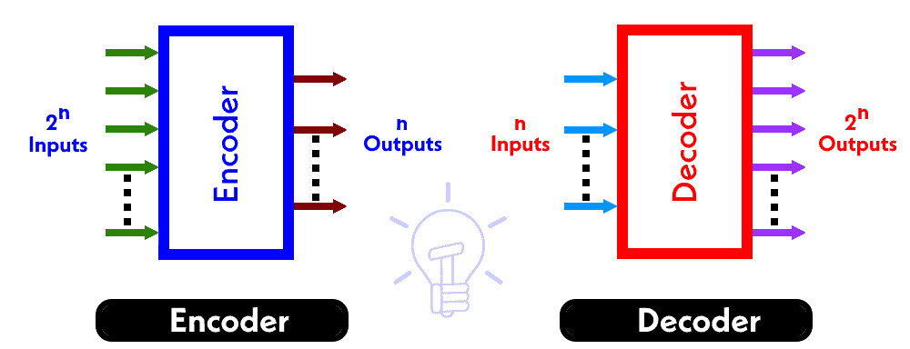
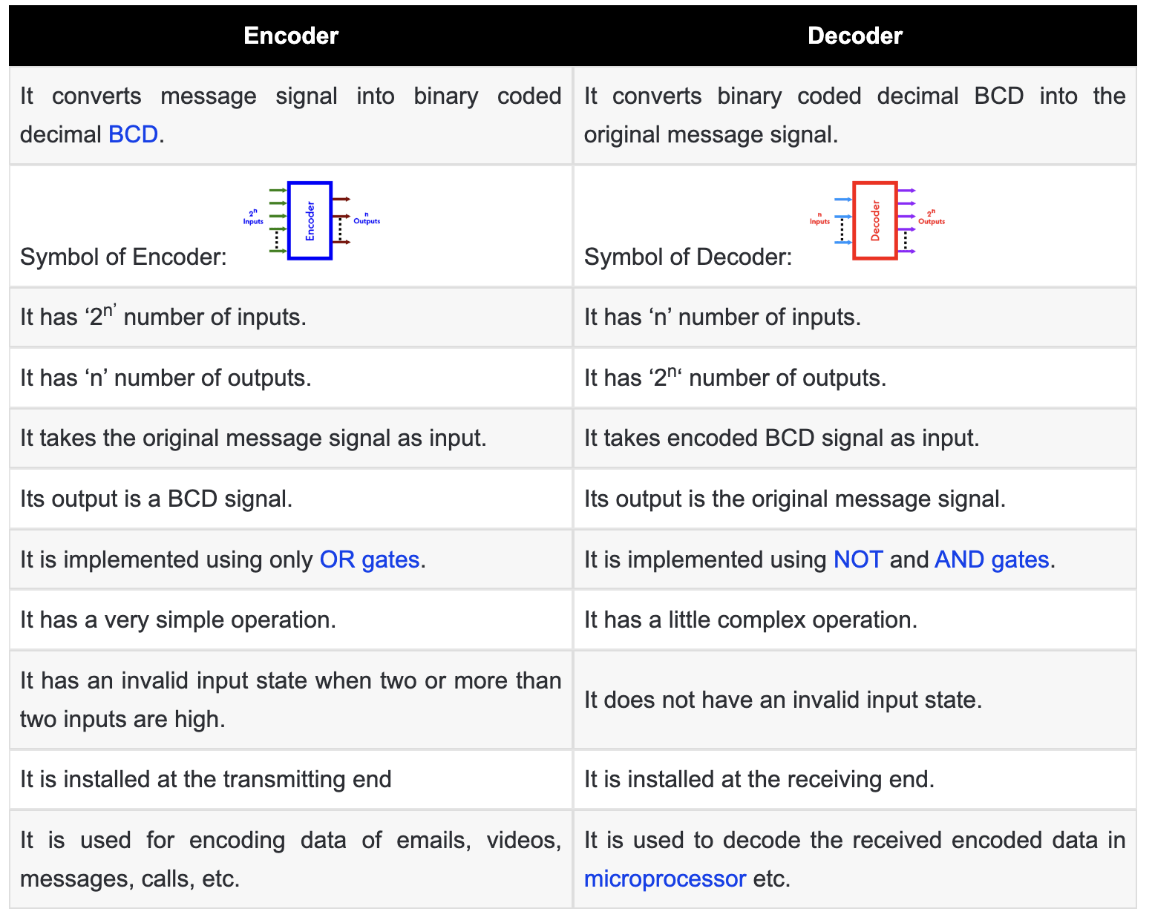
2.8 - Combinational Logic Circuits
Data Simplification: Encoders are used to reduce the number of inputs by converting them into a simpler, shorter code.
Signal Compression: They compress a large amount of input data into fewer outputs, making the transmission more efficient.
Circuit Minimization: Help in designing simpler circuits by minimizing the number of wires needed for connecting a system.
Device Selection: Often used in multiplexing to select a specific device among many, by encoding the selection lines.
Error Detection: Some encoders also include error-detecting and correction features to ensure data integrity.
Binary Encoding: Commonly used to encode analog or multiple binary signals into a single binary code.
Memory Addressing: In digital computers, they play a critical role in forming the address lines to select memory locations.

Slide 22
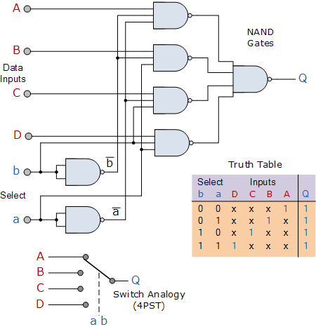
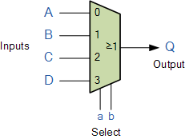
2.9 - Combinational Logic Circuits - Multiplexers
Input Selection: Multiplexers select one input from several digital inputs and forward it to a single output line.
Data Routing: They are used to route data from multiple sources to a single destination, based on selector inputs.
Efficiency in Design: By using multiplexers, complex logic circuits can be simplified, reducing the number of required components and connections.
Signal Gating: They can act as gates that control which signal is allowed to pass through at any given time.
Resource Sharing: Multiplexers enable multiple signals to share a single resource, such as a data bus or communication channel, improving the utilization of system bandwidth.
Conditional Logic: They can implement conditional logic operations by using the select lines to choose the logic result corresponding to the desired condition.
Time Division Multiplexing: In time-division multiplexing systems, multiplexers are crucial in combining signals that share the same channel in different time slots.
Function Implementation: In digital systems, multiplexers can implement any boolean function by appropriately setting the input lines and select signals.

Slide 23
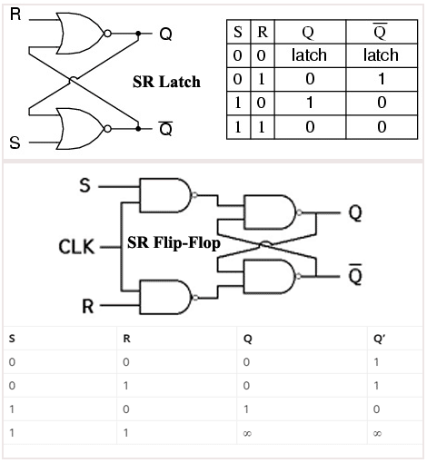
2.10 - Sequential Logic Circuits
Basic Storage Units: Both latches and flip-flops are fundamental building blocks for storing bits in digital circuits.
Latch Functionality: A latch, specifically an SR (Set-Reset) latch, can store a single bit of data using a pair of cross-coupled NOR or NAND gates.
Set and Reset Inputs: The 'S' (Set) input activates the latch to store a '1', while the 'R' (Reset) input clears it to store a '0'.
Output Stability: The latch maintains its output ('Q' and 'not-Q') until the input changes, providing a stable storage mechanism.
Flip-Flop Enhancement: An SR flip-flop is a latch with additional control via a clock signal (CLK) to synchronize data storage.
Clock-Driven Storage: Flip-flops store data on the rising or falling edge of the CLK signal, making them suitable for timed sequences.
State Holding: Both devices hold their state ('1' or '0') until specifically instructed to change, allowing them to function as memory elements.
Forbidden State: For an SR latch or flip-flop, having both S and R set to '1' is usually a forbidden state as it can lead to an indeterminate output.

Slide 24
2.10 - Sequential Logic Circuits
Registers: These are groups of flip-flops that can store multiple bits of data in parallel.
Shift Registers: These are groups of flip-flops that can shift data from one stage to another in serial.
Counters: These are groups of flip-flops that can increment or decrement their stored values according to some logic.
Memory Cells: These are basic units of random-access memory (RAM) that can store one bit of data using different types of transistors or capacitors.

Slide 25
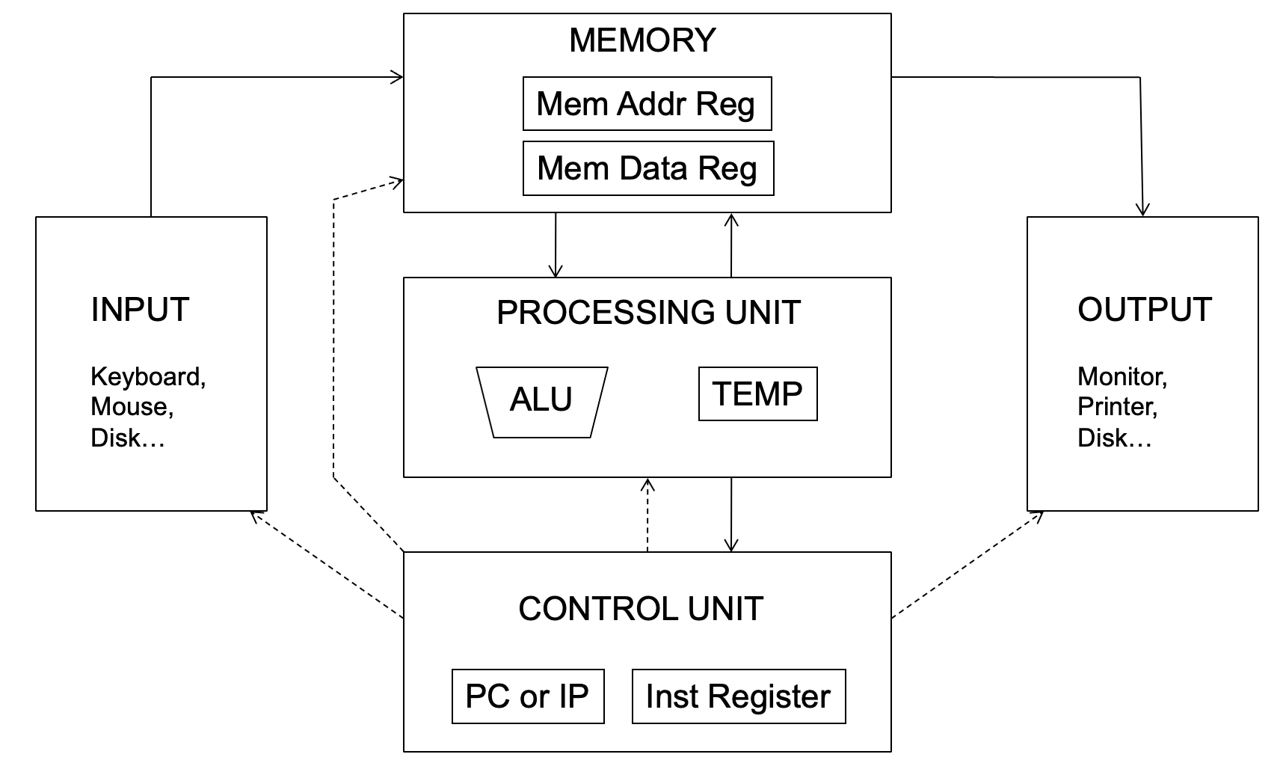
3 - Introduction to the Von Neumann Model
Definition: The Von Neumann Model is a design architecture for a digital computer using a processing unit and a single separate storage structure to hold both instructions and data.
Key Concept: It is based on the stored-program computer concept, where program instructions and data share the same memory space.
Importance: This model forms the basis of most modern computers.

Slide 26
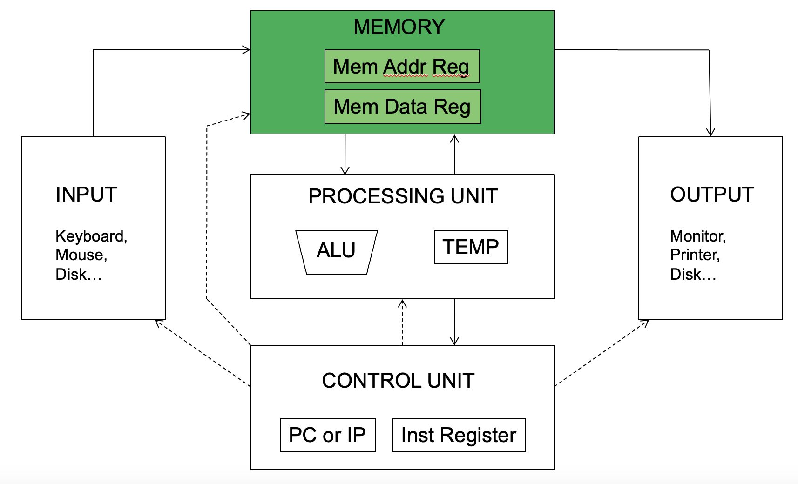
3.1- Introduction to the Von Neumann Model
The memory stores
Data
Programs
The memory contains bits
Bits are grouped into bytes (8 bits) and words (e.g., 8, 16, 32 bits)
How the bits are accessed determines the addressability
E.g., word-addressable
E.g., 8-bit addressable (or byte-addressable)
The total number of addresses is the address space
In LC-3, the address space is 2¹⁶
16-bit addresses
In MIPS, the address space is 2³²
32-bit addresses
In x86-64, the address space is (up to) 2⁴⁸
48-bit addresses

Slide 27
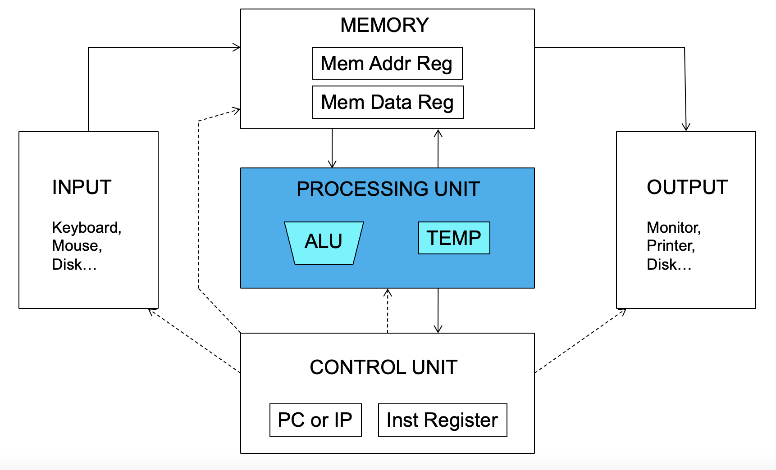
3.2 - Introduction to the Von Neumann Model
The processing unit can consist of many functional units
We start with a simple Arithmetic and Logic Unit (ALU), which executes computations
LC-3: ADD, AND, NOT (XOR in LC-3b)
The ALU processes quantities that are referred to as words
Word length in LC-3 is 16 bits
In MIPS it is 32 bits
Temporary storage: Registers
E.g., to calculate (A+B)*C, the intermediate result of A+B is stored in a register

Slide 28
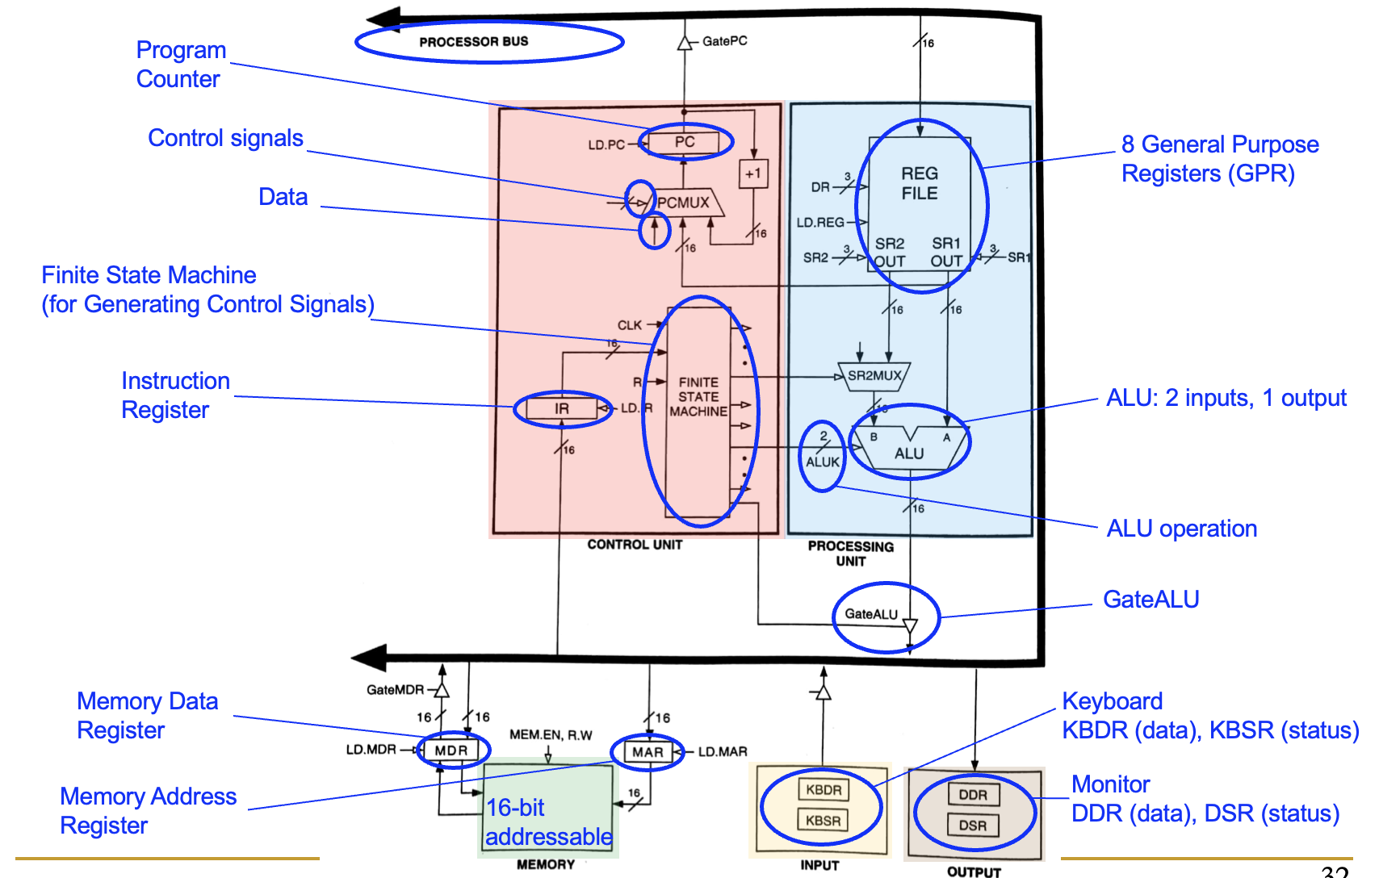
3.3 - Introduction to the Von Neumann Model
Instructions and data are stored in memory
Typically the instruction length is the word length
The processor fetches instructions from memory sequentially
Fetches one instruction
Decodes and executes the instruction
Continues with the next instruction
The address of the current instruction is stored in the program counter (PC)
If word-addressable memory, the processor increments the PC by 1 (in LC-3)
If byte-addressable memory, the processor increments the PC by the word length (4 in MIPS)
In MIPS the OS typically sets the PC to 0x00400000 (start of a program)

Slide 29
3.4 – Exercise
The table below shows the memory from a von Neumann model counter. If the program counter contains 10010, state the data that will be placed in Memory Address register and in Memory Data register.
State the data that will be placed in Memory Address register?
Answer: 10010
State the data that will be placed in Memory Data register Answer: 1110001
Address | Contents
10001 | 11001101
10010 | 11110001
10011 | 10101111
10100 | 10000110
10101 | 00011001
10110 | 10101100
The program counter (PC) holds the address of the next instruction to be fetched from memory.
The binary value 10010 from the PC indicates the address in memory from which data or instruction needs to be fetched.
The Memory Address Register (MAR) holds this address, so it would also contain 10010.
The Memory Data Register (MDR) holds the actual data or instruction fetched from the memory location pointed to by the MAR.
The data located at the memory address is 1110001, which the MDR will hold.

Slide 30
3.5 – Exercise
The six Stages in von Neumann cycle are shown in table below. Put each stage in correct sequence by writing the numbers 1 to 6 in the right column.
Stage | Sequence number
The instruction is then copied from the memory location contained in MAR (Memory address register) and is placed in the MDR (Memory data register) | 3
The instruction is finally decoded and is then executed | 6
The PC (program counter) contains the address of the next instruction to be fetched | 1
The entire instruction is then copied from MDR and placed in IR (Instruction Register) | 4
The address contain in PC is copied to MAR via address bus | 2
The address part of the instruction, if any, is placed to MAR | 5

Slide 31
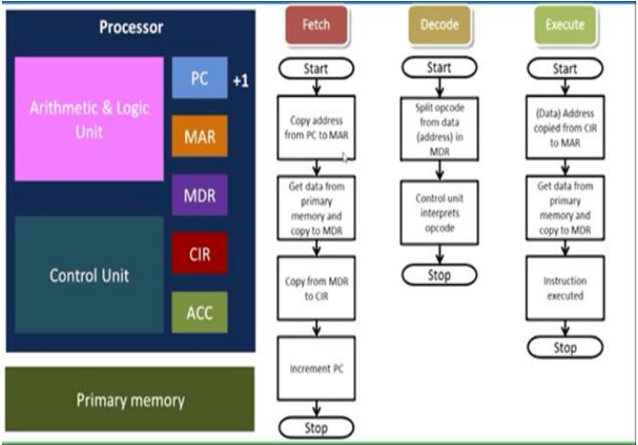
3.5 – Exercise
FETCH
DECODE
EVALUATE ADDRESS
FETCH OPERANDS
EXECUTE
STORE RESULT

Slide 32
4 – LC-3 assembly
Addition
add: mnemonic to indicate the operation to perform
b, c: source operands
a: destination operand
a ← b + c
High-level code
Assembly
a = b + c;
add a, b, c
We map variables to registers
LC-3 registers
b = R1
c = R2
a = R0

Slide 33
4.1 – LC-3 assembly
The assembly instruction ADD R0, R1, R2 is an operation that adds the contents of register R1 to the contents of register R2 and stores the result in register R0.
In LC-3 assembly language, the ADD instruction is represented by the opcode 0001.
The destination register (DR) for this operation is R0, which is represented in binary as 000.
The first source register (SR1) for the addition is R1, represented in binary as 001.
The second source register (SR2) for the addition is R2, represented in binary as 010.
The machine code representation is a 16-bit binary value. The first four bits represent the operation, which in this case is 0001 for ADD.
The next three bits represent the DR, followed by another three bits for SR1.
Since this is a register to register addition, the next bit (bit 5) is a 0, and the subsequent two bits (bit 4 and 3) are unused and also 00.
The final three bits represent SR2.
The entire machine code for this instruction is 0001 000 001 000 010, which, when converted to hexadecimal, is 0x1042.
The hexadecimal representation is a compact form of the binary machine code and is easier to read and use, especially when programming at the machine level or debugging.
LC-3 assembly
ADD R0, R1, R2
Field Values
OP
DR
SR1
SR2
1
0
1
0
00
2
Machine Code
OP
DR
SR1
SR2
0 0 0 1
0 0 0
0 0 1
0
0 0
0 1 0
15
14
13
12
11
10
9
8
7
6
5
4
3
2
1
0
0x1042
Machine Code, in short (hexadecimal)

Slide 34
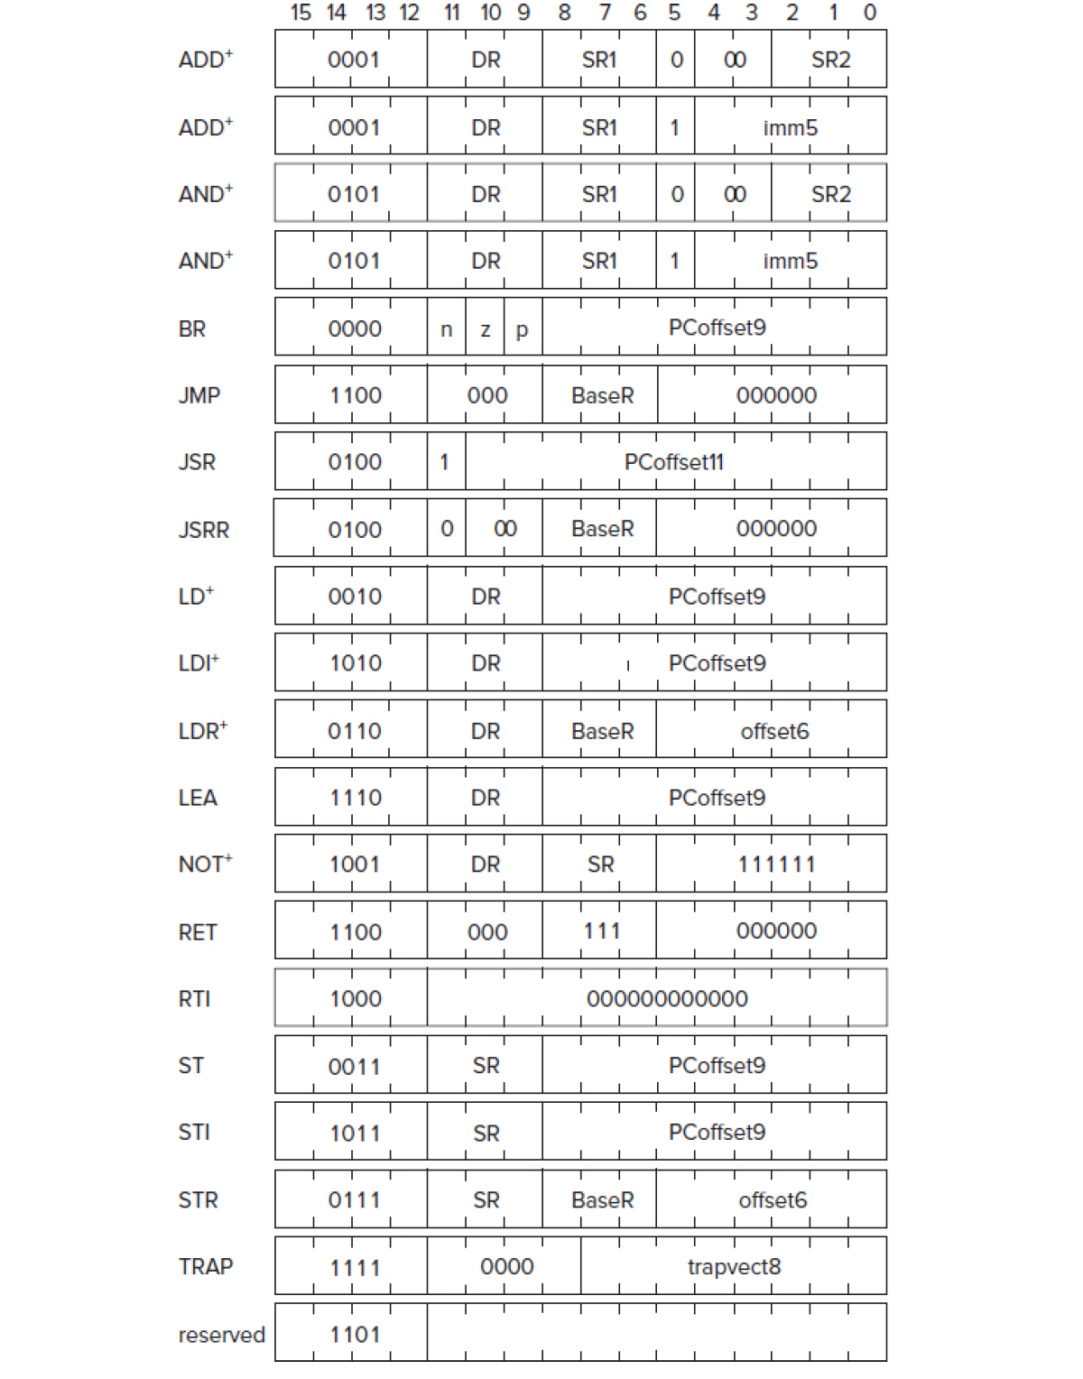
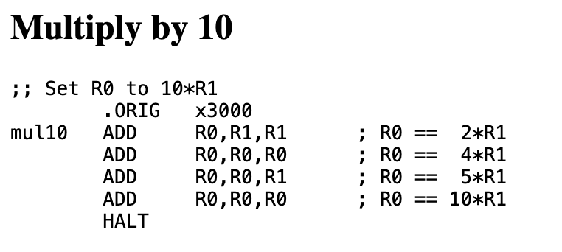
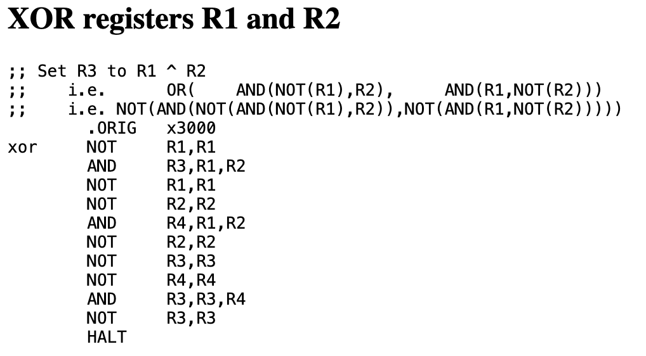
4.2 – LC-3 assembly

Slide 35
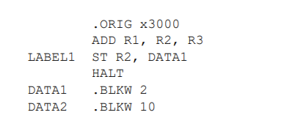
4.3 – Exercise
What are the addresses corresponding to the symbols LABEL1, DATA1, DATA2 in the following code?
The .ORIG x3000 directive sets the starting address of the code to hexadecimal 3000.
First instruction is ADD R1, R2, R3 instruction.
The ST R2, DATA1 instruction will follow immediately after the ADD instruction, thus being at the next address, x3001 where the label is located.
HALT instruction is used to stop the execution of the program. It is effectively a system call that tells the simulator or machine to terminate the current program. When the LC-3 processor executes this instruction, it will cease fetching, decoding, and executing further instructions, and the program will come to a stop.
DATA1 is defined with the .BLKW 2 directive, which reserves 2 words of memory. it will be at address x3003
DATA2 is defined with the .BLKW 10 directive, reserving 10 words of memory. It comes after DATA1, which occupies 2 words. Hence, DATA2 starts at x3003 + 2 = x3005.
In summary, for the given code:
LABEL1 corresponds to address x3001.
DATA1 starts at address x3003.
DATA2 starts at address x3005.

Slide 36

4.4 – Exercise
The following program adds the values stored in memory locations A, B, and C, and stores the result into memory. There are two errors in the code. For each, describe the error and indicate whether it will be detected at assembly or run time.
SUM is not defined – assembly time error.
R1 is not cleared before the ADD operation, run time error (R1 might contain a value and should be set to zero).

Slide 37
4.5 – Exercise
Write an assembly program to read 5 and 6 from memory and multiply them and store the result in R6.
In LC-3 assembly, multiplication is not directly supported as an instruction, so it needs to be implemented using repeated addition.
.ORIG x3000 ; Begin at memory address x3000
LD R1, NUM1 ; Load the first number (5) into R1
LD R2, NUM2 ; Load the second number (6) into R2
AND R6, R6, #0 ; Clear R6 to use as our result register
ADD R3, R1, #0 ; Copy R1 into R3 to use as our counter for the loop
LOOP ADD R6, R6, R2 ; Add R2 to the result R6
ADD R3, R3, #-1 ; Decrement our counter R3
BRp LOOP ; Branch to LOOP if R3 is still positive (hasn't hit zero)
; At this point, R6 contains the result of 5 multiplied by 6
ST R6, RESULT ; Store the result in the memory location labeled RESULT
HALT ; Stop the program
; Memory locations for the numbers and result
NUM1 .FILL x0005 ; Memory location containing the number 5
NUM2 .FILL x0006 ; Memory location containing the number 6
RESULT .BLKW 1 ; Reserve one word of memory to store the result
.END ; End of the LC-3 program

Slide 38

5 - Instruction Set Architecture (ISA)
Definition: ISA defines the set of instructions that a processor can execute and acts as the interface between hardware and software.
Importance: Determines how software communicates with the CPU and affects performance, efficiency, and purpose of the computing system.
Types of ISA:
RISC (Reduced Instruction Set Computing)
CISC (Complex Instruction Set Computing)
VLIW (Very Long Instruction Word)
EPIC (Explicitly Parallel Instruction Computing)

Slide 39
5.1- Characteristics of ISA
Instruction Types:
Data transfer (load/store)
Arithmetic and logical operations
Control flow (jumps and branches)
Instruction Formats:
Fixed-length vs variable-length
Registers:
General-purpose vs special-purpose
Register file size
Addressing Modes:
Immediate, direct, indirect, register, etc.
ISA's Role in Performance:
The complexity and number of instructions directly influence the CPU design and performance.

Slide 40
5.2 - Examples and Comparisons
RISC vs CISC:
RISC: Features a smaller number of simple instructions that can execute within one clock cycle. Example: ARM architecture.
CISC: Features a larger set of more complex instructions, with some executing over multiple clock cycles. Example: x86 architecture.
ISA's Impact on Software Development:
The choice of ISA influences compiler design, assembly language, and ultimately the efficiency of the compiled code.
ISA and Innovation:
Modern advancements such as multi-core processors, SIMD (Single Instruction, Multiple Data) extensions, and out-of-order execution capabilities.

Slide 41

5.3 - What is CPU Pipelining
Definition: A process in computer architecture where multiple instruction processing steps occur in an overlapped manner, improving instruction throughput.
Analogy: Like an assembly line in a factory, where each stage represents a part of the instruction cycle: fetch, decode, execute, memory access, write-back.
Importance: Increases CPU instruction throughput by executing multiple instructions simultaneously at different processing stages.
Basic Concepts:
Instruction cycle and its stages
Parallelism at the instruction level

Slide 42

5.4 - Stages of Pipelining
Fetch: Instruction is fetched from memory.
Decode: Instruction is decoded to understand what action is required.
Execute: The CPU performs the instruction's operation.
Memory Access: The CPU accesses memory if needed (e.g., load or store).
Write-back: The result of the execution is written back to the CPU register.

Slide 43
5.5 - Advantages and Challenges
Advantages:
Increased throughput: More instructions are processed in the same amount of time.
Better CPU utilization: Each part of the processor is continuously active, reducing idle time.
Higher instruction-level parallelism.
Challenges and Solutions:
Hazard handling (structural, data, and control hazards).
Pipelining stalls and how they are mitigated by techniques like instruction reordering, branch prediction, and out-of-order execution.

Slide 44

6 - Interrupts - Signals of System Events
Interrupts are signals sent to the processor to indicate an event that needs immediate attention
Can be generated by hardware (HW interrupts) or software (SW interrupts)
Hardware interrupts can come from I/O devices signaling completion of operations
Interrupts cause the CPU to stop current tasks and execute an interrupt service routine (ISR)

Slide 45
6.1 - System Calls - Interface Between Processes and Kernel
System calls provide a controlled entry point into the operating system's kernel
Allow user-level processes to request services and operations from the kernel
Common system calls include file operations, process control, and communication
System calls involve a context switch from user mode to kernel mode

Slide 46
6.2 - Exceptions - Handling Unusual Conditions
Exceptions are unexpected events during program execution like divide-by-zero errors
Synchronous events triggered by anomalies in program execution (faults, traps)
Managed by the CPU, which invokes exception handling routines
Crucial for maintaining system stability and security

Slide 47

6.3 - Managing System Events: Interrupts, System Calls, and Exceptions
External interrupts are triggered by peripheral devices such as keyboards or network cards.
Hardware and Software Exceptions are unusual conditions detected by the CPU such as division by zero or invalid memory access.
System Calls are requests for service made by a process to the operating system.
Clock Interrupts occur at regular intervals and are typically used for maintaining the system clock and for preemption in multitasking systems.
The Interrupt Service Routine (ISR) is executed in response to an interrupt, handling the event that caused the interrupt.
The scheduler is a system component responsible for deciding the order of task execution, affected by both system calls and clock interrupts.
Kernel is the core part of the operating system managing ISRs, scheduling, and system calls.
The process flow ultimately returns control to the calling process after the interrupt or system call is handled.

Slide 48

6.4 – CPU Scheduling

Slide 49

6.5 – Round Robin
CPU is assigned to the process on the basis of FCFS for a fixed amount of time.
This fixed amount of time is called as time quantum or time slice.
After the time quantum expires, the running process is preempted and sent to the ready queue.
Then, the processor is assigned to the next arrived process.
It is always preemptive in nature.
Burst Time: The time a process needs for CPU execution.
Time Quantum: The fixed time a process is allowed to run before the next process is scheduled.

Slide 50
6.5 – Round Robin
Advantages-
It gives the best performance in terms of average response time.
It is best suited for time sharing system, client server architecture and interactive system.
Disadvantages-
It leads to starvation for processes with larger burst time as they have to repeat the cycle many times.
Its performance heavily depends on time quantum.
Priorities can not be set for the processes.

Slide 51

6.6 - Exercise
Round Robin Scheduling Calculation:
Arrange the processes in the order of their arrival times.
Starting from time 0, assign the CPU to each process for a time period equal to the time quantum or less if the process has less burst time remaining.
After a process is assigned the CPU, if it is not completed, it is placed at the end of the queue.
If the process completes, note the completion time. The waiting time for that process is the completion time minus the arrival time minus the burst time.
The turnaround time for a process is the completion time minus the arrival time.
Continue this process until all processes are completed.

Slide 52
6.7 - Exercise
P1 starts at time 0, runs for 2 time units.
Burst time left: 3.
Current time: 2.
P2 starts at time 2, runs for 2 time units.
Burst time left: 1.
Current time: 4.
P3 starts at time 4, runs for 1 time unit (completed).
P4 starts at time 5, runs for 2 time units.
Burst time left: 0 (completed).
Current time: 7.
P5 starts at time 7, runs for 2 time units.
Burst time left: 1.
Current time: 9.
P1 starts again at time 9, runs for 2 time units.
Burst time left: 1.
Current time: 11.
P2 starts again at time 11, runs for 1 time unit (completed).
P5 starts again at time 12, runs for 1 time unit (completed).
P1 starts again at time 13, runs for 1 time unit (completed).
P1 | P2 | P3 | P4 | P5 | P1 | P2 | P5 | P1
2 | 4 | 5 | 7 | 9 | 11 | 12 | 13 | 14

Slide 53
6.8 - Exercise
For P1:
Arrival time = 0
Completion time = 14
Turnaround time 14−0=14
For P2:
Arrival time = 1
Completion time = 12
Turnaround time 12−1=11
For P3:
Arrival time = 2
Completion time = 5
Turnaround time 5−2=3
For P4:
Arrival time = 3
Completion time = 7
Turnaround time 7−3=4
For P5:
Arrival time = 4
Completion time = 13
Turnaround time 13−4=9
P1 | P2 | P3 | P4 | P5 | P1 | P2 | P5 | P1
2 | 4 | 5 | 7 | 9 | 11 | 12 | 13 | 14

Slide 54


7 - Introduction to Storage Technologies

Slide 55

7.1 - Primary Storage Technologies
Explanation of volatile vs. non-volatile memory
RAM (Random Access Memory)
DDR, DDR2, DDR3, DDR4, and upcoming DDR5
ROM (Read-Only Memory)
PROM, EPROM, EEPROM
Cache memory
L1, L2, L3 caches
Register files within CPUs

Slide 56

7.1 - Magnetic Storage Solutions and SSDs
Hard Disk Drives (HDDs)
How they work (magnetic storage platters, read/write heads)
Evolution of storage capacities and speed
Tape Drives
Used for backups and archives
Advantages of tape for long-term storage
Solid State Drives (SSDs)
Flash-based storage, no moving parts
Advantages over HDDs: Speed, durability, form factor
NAND Flash and NOR Flash
Use in various devices: USB drives, memory cards, smartphones

Slide 57


7.2 – exercise
Consider a disk with a rotational rate of 10,000 RPM, an average seek time of 8 ms, and an average of 500 sectors per track. Estimate the average time to read a random sector from disk. Do this by summing the estimates of the seek time, rotational latency, and transfer time.

Slide 58

7.3 – exercise
Consider a disk with a rotational rate of 10,000 RPM, an average seek time of 8 ms, and an average of 500 sectors per track. Estimate the average time to read a random sector from disk. Do this by summing the estimates of the seek time, rotational latency, and transfer time.

Slide 59

7.5 –Virtual memory

Slide 60

7.7 - Introduction to Paging
Define Paging: A memory management scheme that eliminates the need for contiguous allocation of physical memory.
Purpose: To allow the physical address space of a process to be non-contiguous to avoid external fragmentation and to enable efficient use of memory.
Basic Concept: The virtual memory is divided into blocks of physical memory called "pages."

Slide 61
7.5 - How Paging Works
Virtual Memory Breakdown: The logical address space is divided into blocks of the same size called "pages."
Physical Memory Breakdown: The physical address space is divided into blocks called "frames" that are the same size as pages.
Page Table: Maintains the mapping between the virtual pages and the physical frames.
Translation Lookaside Buffer (TLB): A cache used to reduce the time taken to access the page table during address translation.

Slide 62
7.5 – Exercise : Virtual memory
Assume we have a virtual memory detailed as follows:
256 MB Physical Address Space
4 GB Virtual Address Space
1 KiB page size
A TLB with 4 sets that is 8-way associative with LRU replacement.
For the following questions it is fine to leave your answers as powers of 2. How many bits will be used for:
Answer:
Page offset? _____10______
Virtual Page Number (VPN)? ____22_____
Physical Page Number (PPN)? ___18______
How many entries in this page table? 2^22

Slide 63


7.6 – Exercise : Virtual memory
256 MB Physical Address Space
4 GB Virtual Address Space
1 KiB page size
A TLB with 4 sets that is 8-way associative with LRU replacement.

Slide 64

7.6 - Address Translation in Paging
Logical Address: Consists of a "page number" (p) and a "page offset" (d).
Physical Address: Formed by the "frame number" (f) given by the page table from the page number and the page offset (d).
Example: Address Translation: The CPU generates a logical address of 3532, which is divided into a logical page number (6) by dividing by the page size (512) and an offset (460) by taking the remainder. The page table translates the logical page number (6) into a physical page number (48).
Final Physical Address: To locate the exact memory address, the physical page number (48) is multiplied by the page size (512) and added to the offset (460), resulting in the physical memory address of 25036 where the CPU can access the required data.

Slide 65

7.4 – Exercise
Considering the following page reference string, and the number of frames in the memory is 4, calculate page hit and page miss using LRU.
2, 3, 4, 2, 1, 3, 7, 5, 4, 3, 2, 3, 1

Slide 66
7.4 – Exercise
The page reference string is a sequence that represents pages being accessed over time: 2, 3, 4, 2, 1, 3, 7, 5, 4, 3, 2, 3, 1.
With 4 frames in memory, we apply the Least Recently Used (LRU) algorithm to manage which pages are in memory.
A page hit occurs when a requested page is already in one of the available frames. A page miss occurs when the requested page is not in any frame, necessitating a page replacement.
For the given page reference string, the LRU algorithm results in 4 page hits and 9 page misses as tracked over time.
Page hits are when the page reference matches one of the pages already in the frames. For example, the second '2' and the second and third '3' as well as the last '1'.
Page misses prompt an update to the frames. The least recently used page is replaced with the new page. This is seen when '1' replaces '4', '7' replaces '2', '5' replaces '1', and so on.
The numbers above the frames indicate the sequence of page requests, and the changes in the frames illustrate the LRU algorithm in action.
As a result of the LRU page replacement policy, the frames undergo several changes before all page requests are served, which is depicted in the answer matrix.
The LRU policy ensures that the pages that have not been used for the longest time are replaced first, making room for the newly requested pages.

Slide 67

7.5 - Exercise
Consider a machine with 128 MB physical memory and a 30-bit virtual address space. If the page size is 4KB, what is the approximate size of the page table?

Slide 68

8 - Introduction to Concurrency and Multithreaded Programming
Definition of concurrency in computing: execution of several instruction sequences at the same time.
Multithreaded programming: a technique to allow multiple threads to exist within the context of a single process.
Advantages of multithreading: improved application performance through parallelism, better CPU utilization, and responsive applications.
Challenges with multithreaded programming: managing thread lifecycle, synchronization, shared data access, and deadlocks.

Slide 69

8.1 - Threads vs Processes
Definition and characteristics of a process: an independent entity with its own memory space.
Definition and characteristics of a thread: the smallest sequence of programmed instructions that can be managed independently by a scheduler.
Key differences between threads and processes: memory space, communication, startup time, and context switching overhead.
Use cases for threads and processes: when to choose multithreading over multiprocessing.

Slide 70


8.2 - Context Switching
Explanation of context switching: the process of storing and restoring the state (context) of a CPU so that multiple processes/threads can share a single CPU resource.
The role of the scheduler in context switching and the typical events that lead to a context switch.
Overheads associated with context switching: saving and loading registers, memory maps, and caches.
How context switching impacts performance and scenarios where it's critical to manage it efficiently.

Slide 71

8.3 - Synchronization Mechanisms: Semaphores and Locks
Introduction to synchronization in multithreaded applications: necessity to control the access to shared resources.
Explanation of semaphores: a signaling mechanism to control access to a common resource by multiple threads.
Binary semaphores (mutexes) vs counting semaphores.
Explanation of locks: a mechanism which allows only one thread to access a resource at the same time.
Normal locks vs reentrant locks.
Best practices for using semaphores and locks to avoid common pitfalls like deadlocks and priority inversion.

